Slide 1

Project Final Defence On
Yummy Kitchen Hub
Dhiraj Sapkota
Elisha Rai
Sagar Upadhyaya
(BIT 4th Sem)

Slide 2
CONTENTS
Introduction
Literature Review
Problem Statement
Objectives
Features
ER Diagram & DFD
Proposed Timeline
Future Enhancement
Conclusion

Slide 3


INTRODUCTION
The project “Yummy Kitchen Hub” is a desktop application which we have developed to streamline the operations of a restaurant.
It provides a comprehensive solution for managing various aspects of a restaurant, including menu, order, billing, and transaction records.

Slide 4
Literature Review
We looked at various research papers to understand all the previous work done on the project we undertook.
These studies emphasize the need for efficient management of different aspects of restaurant operations, including order, transaction, billing, and report.

Slide 5
First, research was done on a website named: Restaurant management system. Within this website, there are the following features: Staff Management, Login Admin, Stock Control, and Menu Management.
Pros:
Authentication
User control
Cons:
Technical issues
Complexity
Table management issue

Slide 6
Research on Touch Bistro
Pros:
Easy bill splitting
Offline mode
Reporting and analytics
Cons:
Expensive
Device incompatible

Slide 7
College Canteen Management System
Pros:
Easy to work.
Cons:
Food order placement problem
No accuracy on billing system

Slide 8
Problem Statement
Problem in order placement, processing and billing
Problem in tracking and reporting orders

Slide 9


OBJECTIVES
To provide efficient management of restaurant operations which includes:
menu
Order
Billing
Table
Report

Slide 10
FEATURES
User registration and Login
Managing Menu
Billing
Keeping transaction records
Table Status
Food order placement

Slide 11
Limitation
Offline mode
Lacked inventory management
No customer interaction
Profit calculation excluded

Slide 12
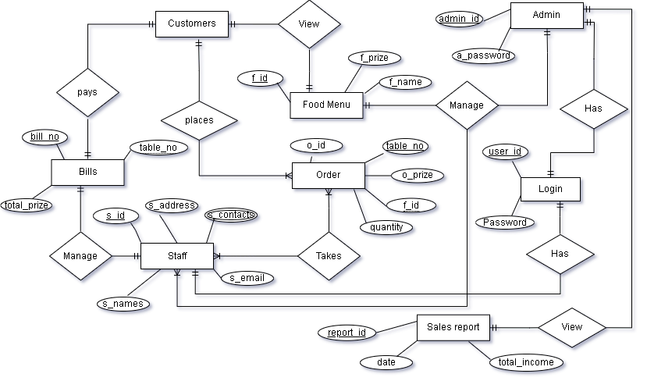
ER Diagram
Fig: ER Diagram

Slide 13
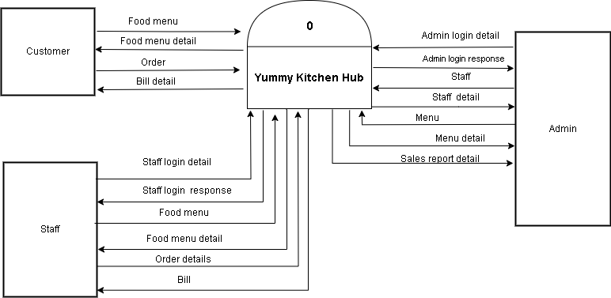
DFD Level 0
Fig: DFD Level 0

Slide 14
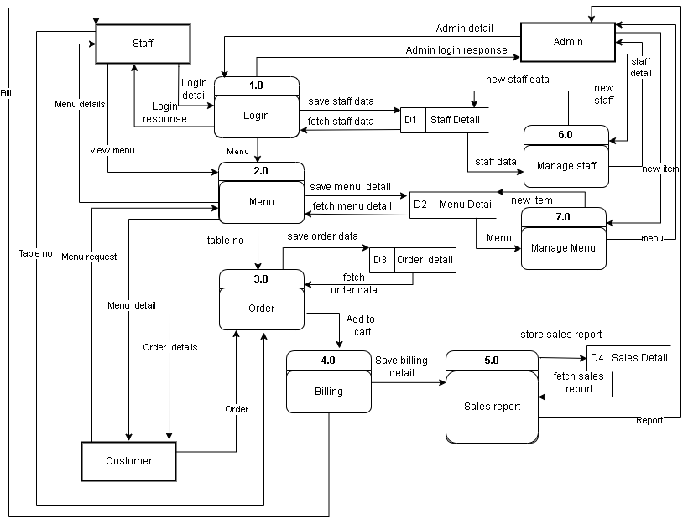
DFD Level 1
Fig: DFD Level 1

Slide 15
Proposed Timelines
Task Name | 2023
 | May | June | July | Aug | Sep
Requirements Gathering
System Design
Coding
Debugging and Testing
Documentation

Slide 16
CONCLUSION
With its fulfilment in features of order placement, menu management, billing, reporting, and security features, it will help for better restaurant operations, reduce manual errors, and provide an enhanced experience for restaurant staff, admin and customers.

Slide 17
Future Enhancement
Online mode enhancement
Inventory management integration
Profit calculations inclusion
Customer interaction features

Slide 18


